Slide 1
CMSC201
Computer Science I for Majors
Lecture 12 – Program Design

Slide 2
Last Class We Covered
Value-returning functions
  None
  Common errors
Function scope
#TBT
Infinite while loops

Slide 3
Any Questions from Last Time?

Slide 4
Today’s Objectives
To learn about modularity and its benefits
To see an example of breaking a large
program into smaller pieces
  Top Down Design
To introduce two methods of implementation
  Top Down and Bottom Up

Slide 5
Modularity

Slide 6
Modularity
A program being modular means that it is:
Made up of individual pieces (modules)
  That can be changed or replaced
  Without affecting the rest of the system
So if we replace or change one function, the rest should still work, even after the change

Slide 7





Modularity
With modularity,
you can reuse and
repurpose your code
What are some pieces of code you’ve
had to write multiple times?
  Getting input between some min and max
  Using a sentinel loop to create a list
  What else?

Slide 8
Functions and Program Structure
So far, functions have been used as a mechanism for reducing code duplication
Another reason to use functions is to make your programs more modular
As the algorithms you design get increasingly complex, it gets more and more difficult to make sense out of the programs

Slide 9
Functions and Program Structure
One option to handle this complexity is to break it down into smaller pieces
Each piece makes sense on its own
You can then combine them together to form the complete program

Slide 10

Helper Functions
These are functions that
assist other functions, or
that provide basic functionality
They are often called
from functions other
than main()

Slide 11
Planning getValidInt()
What about a helper function that is called any
time we need a number within some range?
  Grades: 0 to 100
  Menu options: 1 to N (whatever the last option is)
What should it take in? What should it output?
  Input: the minimum and maximum
  Output: the selected valid number

Slide 12
Creating getValidInt()
Here is one possible way to implement it:
  def getValidInt(minn, maxx):
  message = "Enter a number between " + str(minn) + \
  " and " + str(maxx) + " (inclusive): "
  newInt = int(input(message))
  while newInt < minn or newInt > maxx:
  print("That number is not allowed. Try again!")
  newInt = int(input(message))
  return newInt

Slide 13
Using getValidInt()
Now that the function is written, we can use it
  To get a valid grade
    grade = getValidInt(0, MAX_GRADE)
  To get a menu choice
    printMenu()
    choice = getValidInt(MENU_MIN, MENU_MAX)
  To get a valid index of a list
    index = getValidInt(0, len(myList)-1 )

Slide 14
Complex Problems
If we only take a problem in one piece, it may seem too complicated to even begin to solve
  Create a program that lets two users play a game of checkers
  Search for and present user-requested information from a database of music
  Creating a video game from scratch

Slide 15
Top Down Design

Slide 16
Top Down Design
Computer programmers often use a divide and conquer approach to problem solving:
  Break the problem into parts
  Solve each part individually
  Assemble into the larger solution
One example of this technique is
known as top down design

Slide 17
Top Down Design
Breaking the problem down into pieces makes it more manageable to solve
Top-down design is a process in which:
  A big problem is broken down into small sub-problems
    Which can themselves be broken down into even smaller sub-problems
      And so on and so forth…

Slide 18
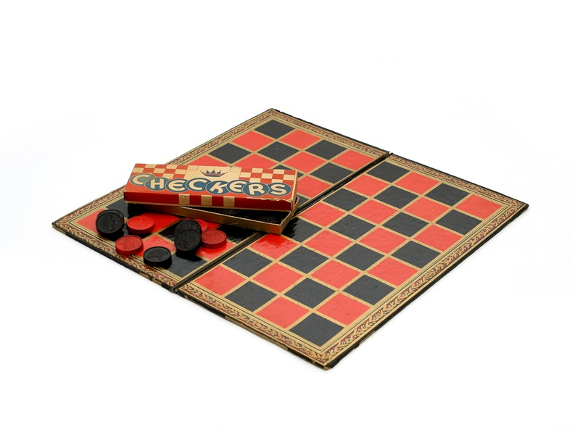
Top Down Design: Illustration
First, start with a clear statement of the problem or concept
A single big idea
Play Checkers

Slide 19
Top Down Design: Illustration
Next, break it down into several parts
Play Checkers
Set up board
Making a move
Checking for win

Slide 20
Top Down Design: Illustration
Next, break it down into several parts
If any of those parts can be further broken down, then the process continues…
Play Checkers
Set up board
Making a move
Checking for win
Switch players
Get user move
Move piece
Count
pieces

Slide 21
Top Down Design: Illustration
And so on…
Play Checkers
Set up board
Making a move
Checking for win
Switch players
Get user move
Move piece
Get valid
indexes
Count
pieces
Check move
validity

Slide 22
Top Down Design: Illustration
Your final design might look like this chart, which shows the overall structure of the smaller pieces that together make up the “big idea” of the program
Play Checkers
Set up board
Making a move
Checking for win
Switch players
Get user move
Move piece
Get valid
indexes
Count
pieces
Check move
validity

Slide 23
Top Down Design: Illustration
This is like an upside-down
“tree,” where
each of the
nodes represents
a single process
(or a function)
Play Checkers
Set up board
Making a move
Checking for win
Switch players
Get user move
Move piece
Get valid
indexes
Count
pieces
Check move
validity

Slide 24
Top Down Design: Illustration
The bottom nodes are “leaves” that represent pieces
that need to be developed
They are then recombined to
create the solution to the original problem
Play Checkers
Set up board
Making a move
Checking for win
Switch players
Get user move
Move piece
Get valid
indexes
Count
pieces
Check move
validity

Slide 25
Top Down Design
We’ve created a simplified design that’s easy to follow
Still missing a couple pieces, but it’s a start!
  There’s also no plan included for main() in this design
Play Checkers
Set up board
Making a move
Checking for win
Switch players
Get user move
Move piece
Get valid
indexes
Count
pieces
Check move
validity

Slide 26
Analogy: Essay Outline
Think of it as an outline for a essay you’re writing for a class assignment
You don’t just start writing things down!
  You come up with a plan of the important points you’ll cover, and in what order
  This helps you to formulate your thoughts as well

Slide 27
Implementing a Design in Code

Slide 28
Bottom Up Implementation
Develop each of the modules separately
  Test that each one works as expected
Then combine into their larger parts
  Continue until the program is complete
Play Checkers
Set up board
Making a move
Checking for win
Switch players
Get user move
Move piece
Get valid
indexes
Count
pieces
Check move
validity

Slide 29
Bottom Up Implementation
To test your functions, you will probably use main() as a (temporary) test bed
  You can even call it testMain() if you want
Call each function with different test inputs
  How does the board setup work if it’s 1x1?
  Does the if/else work when switching players?
  Ensure that functions “play nicely” together

Slide 30
Top Down Implementation
Sort of the “opposite” of bottom up
Create “dummy” functions that fulfill the requirements, but don’t perform their job
  For example, a function that is supposed to
  get the user move; it takes in the board, but simply returns that they want to move to 0, 0
Write up a “functional” main() that calls these dummy functions
  Helps to pinpoint other functions you may need

Slide 31
Which To Choose?
Top down? Or bottom up?
It’s up to you!
  As you do more programming, you will develop your own preference and style
For now, just use something – don’t code up everything at once without testing anything!

Slide 32
Daily emacs Shortcut
CTRL+V
  Moves the screen down one “page”
M+V
  Moves the screen up one “page”

Slide 33
Announcements
Project 1 is out on Blackboard now
  Design is due by Friday (Mar 29th) at 11:59:59 PM
    Design is provided, but you must still think about it carefully to figure out how everything fits together!
  Project is due by Friday (Apr 5th) at 11:59:59 PM
Second midterm exam is April 15th and 16th

Slide 34
Image Sources
Puzzle pieces (adapted from):
  https://pixabay.com/p-308908/
Helping hands:
  https://pixabay.com/p-40805/
Checkers:
  https://en.wikipedia.org/wiki/File:The_Childrens_Museum_of_Indianapolis_-_Checkers.jpg

